Slide 1
Basics of Science writing
Prof. Krishna Misra, Ph.D., FNASc,FBRSI
Sept,29, 2021

Slide 2
Career as Science Writer
Science writer is a person with a science background who writes as a major part of his/her job.
Writing careers for scientists are very diverse and include
1.Traditional science journalism
2.Medical writing
3Technical writing/editing (thesis & research paper)
4.Marketing
5.Science textbook publishing , etc

Slide 3
Science journalism
Science journalists may work as science, health, or medical reporters for newspapers, as staff writers for magazines (e.g. Newsweek), and as freelance writers specializing in science topics. Freelancers sell their work to newspapers, magazines, and electronic outlets

Slide 4
Medical Writing
Medical writers may work for pharmaceutical companies, government agencies, hospitals, medical schools, non-profit organizations, publishing houses, or on contract through consulting firms.
Medical writers have to be conversant with not only medical terms but also Bioinformatics terms to be used e.g. for telemedicine, medical informatics and drug designing .

Slide 5
Technical writing/editing
Technical science writers may work for pharmaceutical / biotech companies or in other industrial fields, especially the computer industry.
Topics may include protocols for customers (e.g. physicians, scientists) or in-house staff, product specifications and instructions.
The science writing program at University of California, Santa Cruz,1156 High Street, Santa Cruz, USA, has produced professional science writers since 1981.
The program is one academic year long, with internships throughout the school year and the following summer.
Some well-known scientific journals including Science, Nature, New Scientist, Scientific American, Down to Earth, have dedicated science writers with them

Slide 6
Master’s programs in US for Science writing and communication
School Location
Johns Hopkins University Online; Baltimore, MD; Washington, DC
Massachusetts Institute of Technology (MIT) Cambridge, MA
New York University (NYU) New York City, NY
Texas A&M University College Station, TX

Slide 7
Homi Bhabha Centre for Science Education (HBCSE) a National Centre of the Tata Institute of Fundamental Research, Mumbai.
Runs a one year Science writing program since 2001
Overview:
Types of articles, target audience,
purpose and motivation of a writer,
organization of an article (title, introduction, middle, end)
sources of information,
qualities of a good article, language (grammar, punctuation, terminology, qualities of discourse), aids (illustrations, tables, boxes, examples, references) Summary (descriptive, informative),
scope and limitations of an article, editing, ethical responsibilities of a writer.

Slide 8
S. Ramaseshan Science Writing Fellowships/Internships at Current Science Association (IISc.Bangalore)
The Current Science Association has instituted Science Writing Fellowships in memory of Professor Sivaraj Ramaseshan for his contributions to the journal Current Science and science writing / internships for working in the editorial office of the journal.
Candidates must possess a basic degree. Candidates with postgraduate (after B.Sc.) degree in biosciences, literature, journalism or mass communication can also apply for the fellowship or internship. Preference is given to graduates in physics and/or chemistry.
Fellowships are awarded to a limited number of exceptionally motivated candidates for a period of one year, extendable for a further period of one year depending on performance.

Slide 9
Desirable qualifications………
Desirable: A flair for writing and wide interest in diverse areas of science with basic computer skills.
Age: Not more than 35 years as on 1 March of the year of application.
Job description: Selected candidates are expected to write for the News, Research News, and General sections of the journal Current Science on a regular basis.
Selected candidates are normally based in Bangalore and are expected to assist the editorial staff in the publication of Current Science.
Applications, which must include a detailed CV and reprints of popular science publications, must be sent to the Executive Secretary, Current Science Association ,Sadashivnagar , Bangalore 560 080 .

Slide 10
Other Science communication programs in India
The present government is encouraging children to submit their scientific ideas and write-ups for further pursuit.
Dr Harsh Vardhan, Ex Union Minister for Science & Technology & Earth Sciences launched the AWSAR (Augmenting Writing Skills for Articulating Research) programme along with other new programs of DST in a ceremony held on January 24, 2018 at CSIR.
AWSAR has been initiated to encourage, empower and endow popular science writing through newspapers, magazines, blogs, social media, etc. by young PhD Scholars and Post-Doctoral Fellows during the course of their higher studies and research pursuits.
The India Science Media Fellowships 2019 is a joint venture of the Wellcome Trust/DBT India Alliance (India Alliance) and Nature India to encourage coverage of science in the Indian media.
The Wellcome Trust/DBT India Alliance is an £160 million initiative funded equally by the Wellcome Trust, UK and Department of Biotechnology, India.
Vigyan Prasar, Govt of India also organizes a short training programme with Indian Science News Association, Kolkata and involves science communicators to develop and disseminate software materials and organise popular science events throughout the country.

Slide 11
Why become Science Communicators
The demand for science journalists is slowly increasing and as there are very few people really dedicated to this field
Full time engagement of science communicators is yet to mature but likely to do so in the near future.
Government has now become aware of the role of science communicators and has started several schemes and projects for them.
Provision has been made in different agencies, NGOs and institutes (names) to hire persons with good science communication skills.
DST, DBT, ICMR, DRDO, CSIR, have started some fellowship for science writers, particularly ladies, who could sit in their house and communicate.
National Council for Science and Technology Communication (NCSTC), DST was established to integrate, coordinate, catalyse and support science communication and popularisation.
The National Institute of Science Communication (NISCOM), CSIR have been publishing popular science journals and books.

Slide 12
Future of Science communication in India
Several NGOs organise science communication programmes.
The Indian Science Writers' Association (ISWA), undertakes training courses, lectures and fellowships with other government agencies in promoting science communication activities.
Science based films and books including science friction are slowly becoming popular.
Hence, the future prospects of science communication as a career look to be promising.
However, more young minds need to be attracted to this area and more courses on science journalism to be developed in different universities and colleges to create dedicated science communicators in near future

Slide 13
Communicating Science Different types of Scientific writing
Papers in journals (main method of Science communication)
Review papers
Conference abstracts & papers
Project proposals
Theses and dissertations
Popular science and newspaper articles
Oral & poster presentations
Reports/case studies
Interviews and discussions
Computer mediated information

Slide 14
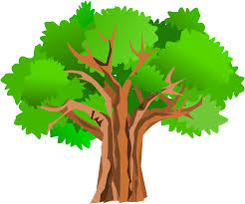
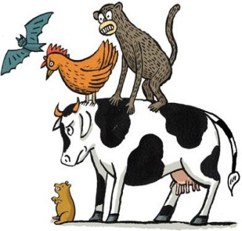


Communicating Research Results

Slide 15
Basic requirements of Science communication
Science knows no boundaries, it is Global. The message should be ,
Brief & accurate
Consistent/coherent
Logical
Clear
Adaptable for audience , so that message is well received and understood

Slide 16


Major Components Of Effective Communication
Message
Mapping of references
Who
Why
Writer/ Speaker
What
How
Audience

Slide 17
Interaction with Audience
Effective communication is not only delivering message but also includes questions and answers
Who are you addressing?
Why is your message important?
What is your “take home “message?
How to best deliver your message and satisfy the
audience?
Popular science writing is equally important as communicating your research results in science journals

Slide 18
The message determines the medium for formal publication
What message do I want to convey?
What format is most appropriate for my message?
Who will be interested in my message?
Where should this paper be published?

Slide 19
Getting started in writing
“Find a subject you care about and which in your heart feel others should care about . It is this genuine caring , not your games with language , which will be the most compelling and seductive element in your style”
-( Kurt Vonnegut)
Research must be made known if it is to have lasting value

Slide 20
Composing first draft
Writing is an adventure. To begin with it is a toy and an amusement. Then it becomes a mistress, then it becomes a master, then it becomes a tyrant. This last phase is just as you are about to be reconciled to your servitude , you kill the monster and fling him to the public.
………………………………….Winston Churchill

Slide 21
Preparing to write
No need to feel tense, since no document is written in single step.
Divide your writing in several stages to make the task easier
Analyse your objective and audience
Make tables, figures and other visuals depicting your interesting results and decide what message to communicate
Structure your writing (make an outline)
Start with the easiest parts and write the draft
Revise and edit

Slide 22
Making Outline facilitates writing
Make a preliminary outline, splitting writing into steps and sub-steps keeping a coherence throughout.
Use key words for each step and sub-step
This organizes your thoughts to make your text logical and clear
This also helps in not missing any important part.
The outline may also be written as an organizational chart or a mind –map
The outline should be revised continuously throughout your writing
Discuss your proposed outline with your co-authors, colleagues or mentor/supervisor to reduce larger revisions later

Slide 23
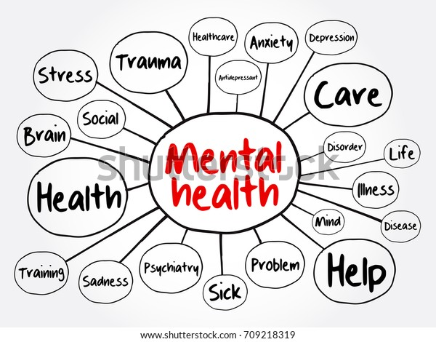
Mental Health Mind Map Flowchart

Slide 24
Making your writing easier to read
Choose British English rather than US English
Developing solid writing skills is a matter of hard work and practice.
“The difficulty of literature is not to write , but to write what you mean” ( Robert Louis Stevenson)
If writing is easy for you , then your writing will be easy to read

Slide 25
Writing correctly
Avoid making errors e.g., spelling , grammar ,punctuation and choice of words
Use spell- check software for errors in spelling
Be careful, since there is danger of introducing errors rather than correcting them (use of wrong computer dictionary US vs British).
Grammar checking software gives good suggestions but often does not cope with scientific writings.

Slide 26
Writing a Science Research Article: Principles and Pitfalls
Three principles of good science writing:
clarity, accuracy, and concision.
Know about common pitfalls in English grammar, style and usage so you can write your article with more confidence.
Learn the nuances of science writing and communicate your research effectively.
Understand how to avoid the most common errors in English writing.

Slide 27
Acquire Art of Scientific Writing by Practice; Become Science Communicators
THANK YOU

